Slide 1

Weather Automation Report
Vicky Xueqing, Joshua Ellingson & Innocent Musyoka

Slide 2

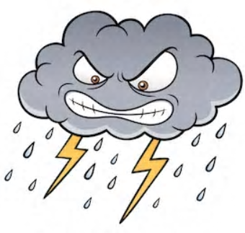



Project Overview
We aspired to create a code that would prompt the user to provide a zip code, that in turn would return certain weather criteria.
A more ambitious idea, was to then generate an automated "notification" to certain specific individuals via either Gmail, WeChat, Facebook or other social media platforms.

Slide 3

API Application Programming Interfaces
API – is used for software applications to send and receive data. API can also connect one program to another, to share functionality (Like the bridge between ATM and bank account)…….
An API key – is a unique identifier used to connect to, or perform, an API call.
RapidAPI: https://rapidapi.com/interzoid/api/us-weather-by-zip-code

Slide 4
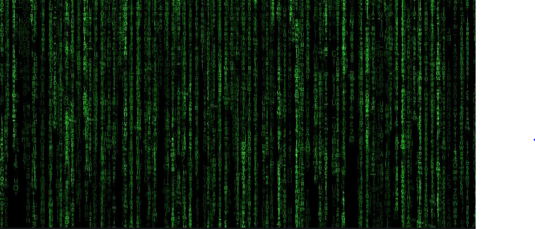

Libraries
Requests – A module used to, well..."request" certain information from a respective URL.
Once the request is made to the URL (website) of our choosing, it will return the data in a 'JSON' format

Slide 5
Libraries
Json (JavaScript Object Notation) is a data-type (format) that works well with many API's
Json is similar to a "savable" version of a dictionary

Slide 6
Pseudocode
Go to https:\/\/docs.rapidapi.com\/docs\/keys to learn how to get your API applicati
Go to https:\/\/docs.rapidapi.com\/docs\/keys to learn how to get your API ap
Import required modules (requests, json)
Define the function weather
Acquire an API key Instructions here.
Use the “try and except” to for error handling.
Use “while True” statement to create a loop so that for as long as the conditions above are met, the program will continue to run indefinitely

Slide 7
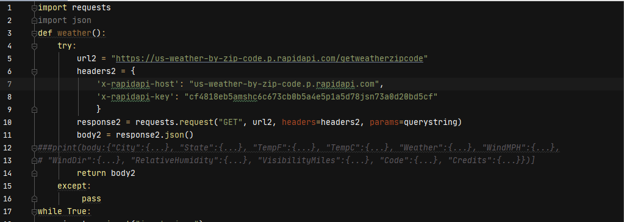

Slide 8
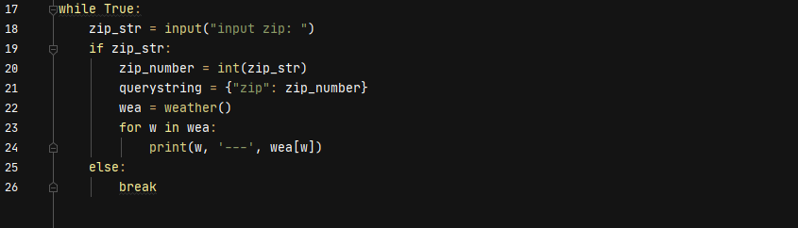
-

Slide 9

Thank You!

